Slide 1

2018-2026 and beyond

Slide 2
Outline
-Security BSides: The origin story
-A brief history of Security BSides Oslo
-Where we’re headed
-How to (re)organize ourselves for the future

Slide 3
Security BSides: The origin story
Started 2009 in Las Vegas as a more accessible, less commercial “overflow” for Blackhat/Defcon.
Now 1,200 BSides events held across 274 cities in 68…

Slide 4
A brief history of BSides Oslo
2015: OsloSec Meetup started.
2018: Discussions led to action: non-profit formed to plan & run a Security BSides conference in Oslo.
2019: First single-day, single-track BSides Oslo conference held at MESH for ~100 people. Sold out.
2020: Signed an agreement with a larger venue (Vulkan Arena / Pokalen), postponed due to COVID-19.
2021: Free Digital Edition to offer something to the community who had bought tickets and were waiting.
2022: Sold-out physical event for ~250 people at the new venue. Same single-day, single-track format.
2023-2026: Annual sold-out events with minor changes along the way.

Slide 5
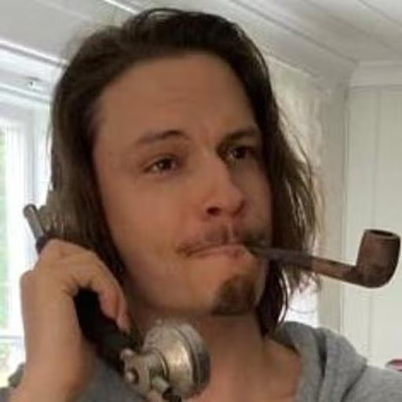
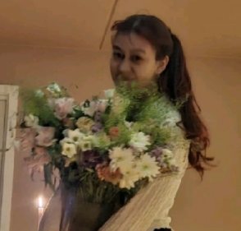
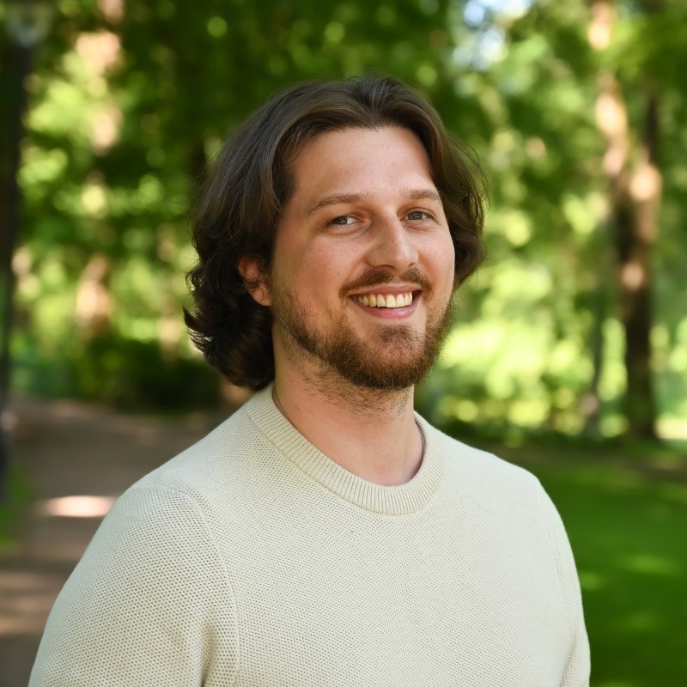
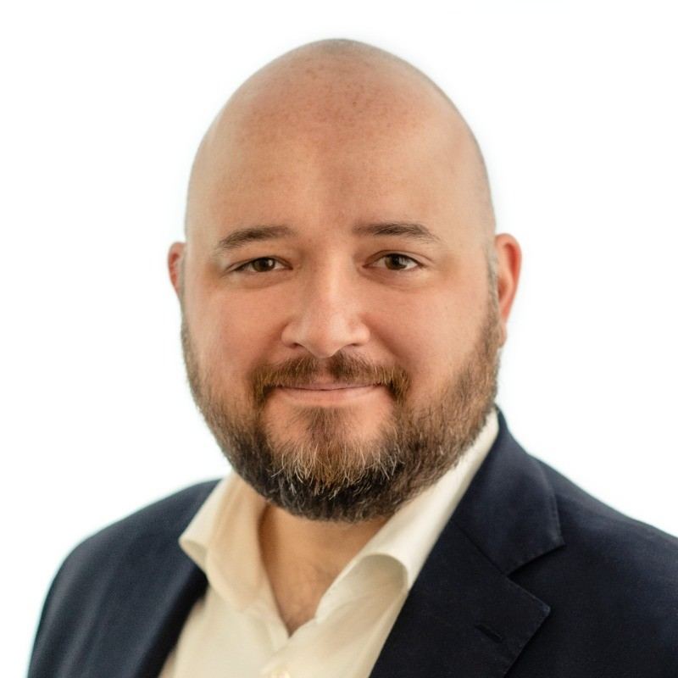
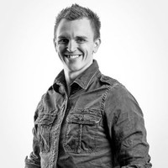
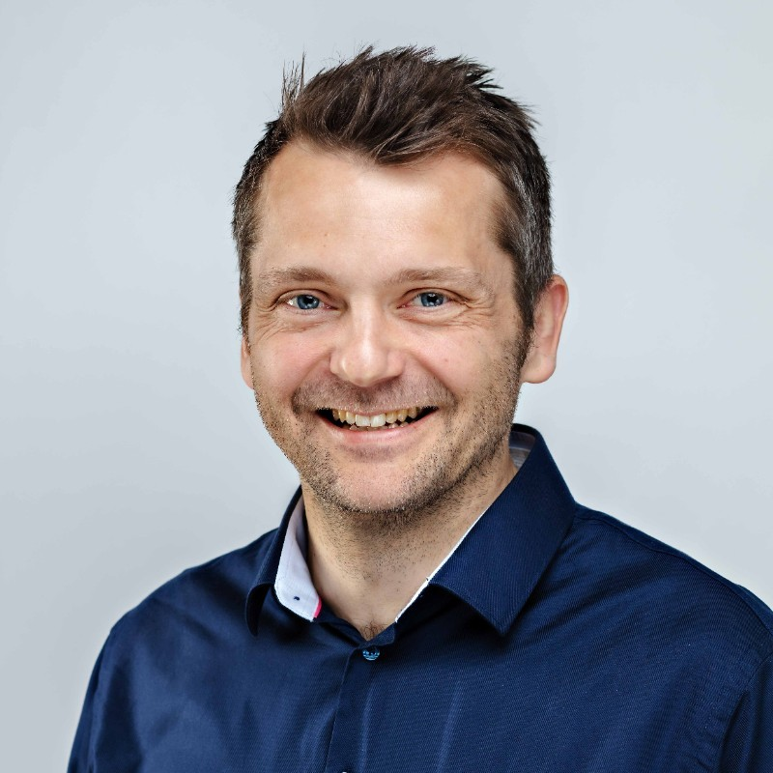
Introducing the team

Slide 6
What we learned & changed along the way
People drink a lot of soda for breakfast…
Sponsorship packages are not tax free $$$ : |
Villages are cooler than CTFs
People take vacation in summer
Sponsors don’t use their tickets
Buying t-shirts is better than picking them up
Order more sandwiches!
Do your due diligence

Slide 7
Rough annual timeline (easy mode)
CFP
close, select & contact speakers
Date / venue announced
CFP
open
Shirt sales
close, order shirts
Videos published
Sponsorship, ticket, shirt sales open
Participant reminder, badge order
Retro & julebord
Publish final speaker lineup
Participant feedback survey
Jan
Feb
Mar
Apr
May
Jun
Jul
Aug
Sep
Oct
Nov
Dec

Slide 8
Infra (it works!)
LetsReg (formerly Deltager.no) - ticket sales
Ryan’s Google - Storage, meetings, CFP form
Trello - CFP mgmt
Zapier - Automation of CFP submit confirmation & Trello card
Domeneshop - webmail & registrar
Github - Webhost
Conta - Invoicing (used to be free, isn’t anymore… shocker)
Signal - Comms
Socials…
Vulkan Arena - Venue, catering, sound, security, bartenders, etc.
Other vendors - shirts

Slide 9
Why it’s time to make the leap to a new venue
-We are selling out earlier each year with more requests for waiting list.
-The downstairs social / chill zone + sponsor area + breakfast / lunch room + village space is too crowded and limits our ability to increase participation.
-Villages are extremely popular with our community and could use much more space.
-Would be our biggest change to date–an opportunity to “relaunch” and really freshen things up.
-A “proper” conference venue (probably) gives more flexibility for the future.
-We have accumulated a (small) buffer in case things don’t go as planned.

Slide 10
Challenges going to a new venue
-Initial assessment of options in early 2025 suggests significant cost increase to move to a larger venue (~50-100%).
-Will require a rework of sponsor packages, pricing and/or sales.
-Will require more people.
-No perfect venue for the event as we’ve run it in the past.

Slide 11
Org structure / re-org
2025
-board/org committee + venue search committee
2026
-board
-org committee
-other?

